Slide 1
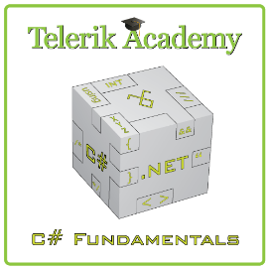
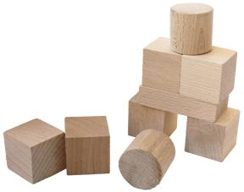


Methods
http://csharpfundamentals.telerik.com
Subroutines in Computer Programming
Svetlin Nakov
Technical Trainer
www.nakov.com
Telerik Software Academy
academy.telerik.com

Slide 2

Table of Contents
Using Methods
What is a Method? Why to Use Methods?
Declaring and Creating Methods
Calling Methods
Methods with Parameters
Passing Parameters
Returning Values
Best Practices

Slide 3

What is a Method?
A method is a kind of building block that solves a small problem
A piece of code that has a name and can be called from the other code
Can take parameters and return a value
Methods allow programmers to construct large programs from simple pieces
Methods are also known as functions, procedures, and subroutines

Slide 4

Why to Use Methods?
More manageable programming
Split large problems into small pieces
Better organization of the program
Improve code readability
Improve code understandability
Avoiding repeating code
Improve code maintainability
Code reusability
Using existing methods several times

Slide 5


Declaring and Creating Methods

Slide 6

Declaring and Creating Methods
Method name
static void PrintLogo()
{
Console.WriteLine("Telerik Corp.");
Console.WriteLine("www.telerik.com");
}
Each method has a name
It is used to call the method
Describes its purpose

Slide 7
Declaring and Creating Methods (2)
static void PrintLogo()
{
Console.WriteLine("Telerik Corp.");
Console.WriteLine("www.telerik.com");
}
Methods declared static can be called by any other method (static or not)
This will be discussed later in details
The keyword void means that the method does not return any result

Slide 8

Declaring and Creating Methods (3)
Method body
static void PrintLogo()
{
Console.WriteLine("Telerik Corp.");
Console.WriteLine("www.telerik.com");
}
Each method has a body
It contains the programming code
Surrounded by { and }

Slide 9

Declaring and Creating Methods (4)
using System;
class MethodExample
{
static void PrintLogo()
{
Console.WriteLine("Telerik Corp.");
Console.WriteLine("www.telerik.com");
}
static void Main()
{
// ...
}
}
Methods are always declared inside a class
Main() is also a method like all others

Slide 10

Calling Methods

Slide 11

Calling Methods
To call a method, simply use:
The method’s name
Parentheses (don’t forget them!)
A semicolon (;)
This will execute the code in the method’s body and will result in printing the following:
PrintLogo();
Telerik Corp.
www.telerik.com

Slide 12

Calling Methods (2)
A method can be called from:
The Main() method
Any other method
Itself (process known as recursion)
static void Main()
{
// ...
PrintLogo();
// ...
}

Slide 13
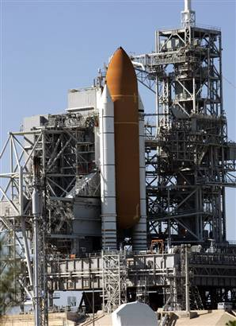

Declaring and Calling Methods
Live Demo

Slide 14
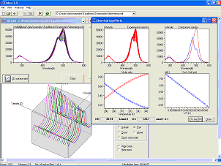
Methods with Parameters
Passing Parameters and Returning Values

Slide 15
Method Parameters
To pass information to a method, you can use parameters (also known as arguments)
You can pass zero or several input values
You can pass values of different types
Each parameter has name and type
Parameters are assigned to particular values when the method is called
Parameters can change the method behavior depending on the passed values

Slide 16

Defining and Using Method Parameters
static void PrintSign(int number)
{
if (number > 0)
Console.WriteLine("Positive");
else if (number < 0)
Console.WriteLine("Negative");
else
Console.WriteLine("Zero");
}
Method’s behavior depends on its parameters
Parameters can be of any type
int, double, string, etc.
Arrays (int[], double[], etc.)

Slide 17
Defining and Using Method Parameters (2)
Methods can have as many parameters as needed:
The following syntax is not valid:
static void PrintMax(float number1, float number2)
{
float max = number1;
if (number2 > number1)
max = number2;
Console.WriteLine("Maximal number: {0}", max);
}
static void PrintMax(float number1, number2)

Slide 18

Calling Methods with Parameters
To call a method and pass values to its parameters:
Use the method’s name, followed by a list of expressions for each parameter
Examples:
PrintSign(-5);
PrintSign(balance);
PrintSign(2+3);
PrintMax(100, 200);
PrintMax(oldQuantity * 1.5, quantity * 2);

Slide 19
Calling Methods with Parameters (2)
Expressions must be of the same type as method’s parameters (or compatible)
If the method requires a float expression, you can pass int instead
Use the same order like in method declaration
For methods with no parameters do not forget the parentheses

Slide 20
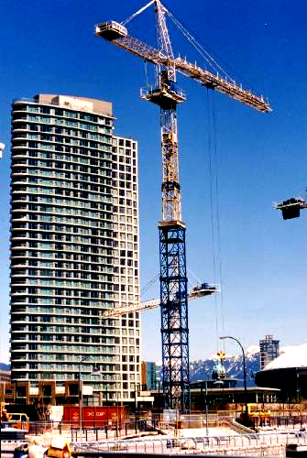
Using Methods With Parameters
Examples

Slide 21
Methods Parameters – Example
static void PrintSign(int number)
{
if (number > 0)
Console.WriteLine("The number {0} is positive.", number);
else if (number < 0)
Console.WriteLine("The number {0} is negative.", number);
else
Console.WriteLine("The number {0} is zero.", number);
}
static void PrintMax(float number1, float number2)
{
float max = number1;
if (number2 > number1)
{
max = number2;
}
Console.WriteLine("Maximal number: {0}", max);
}

Slide 22

Method Parameters
Live Demo

Slide 23
Months – Example
Display the period between two months in a user-friendly way
using System;
class MonthsExample
{
static void SayMonth(int month)
{
string[] monthNames = new string[] {
"January", "February", "March",
"April", "May", "June", "July",
"August", "September", "October",
"November", "December"};
Console.Write(monthNames[month-1]);
}
(the example continues)

Slide 24
Months – Example (2)
static void SayPeriod(int startMonth, int endMonth)
{
int period = endMonth - startMonth;
if (period < 0)
{
period = period + 12;
// From December to January the
// period is 1 month, not -11!
}
Console.Write("There are {0} + months from ", period);
SayMonth(startMonth);
Console.Write(" to ");
SayMonth(endMonth);
}
}

Slide 25
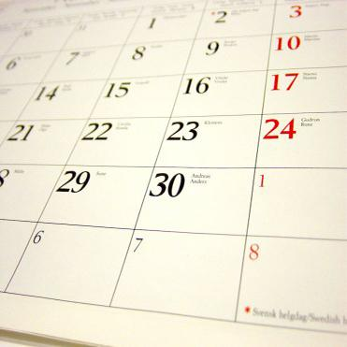
Months
Live Demo

Slide 26
Printing Triangle – Example
Creating a program for printing triangles as shown below:
1
1 1 2
1 2 1 2 3
1 2 3 1 2 3 4
1 2 3 4 1 2 3 4 5
n=5 🡪 1 2 3 4 5 n=6 🡪 1 2 3 4 5 6
1 2 3 4 1 2 3 4 5
1 2 3 1 2 3 4
1 2 1 2 3
1 1 2
1

Slide 27
Printing Triangle – Example
static void Main()
{
int n = int.Parse(Console.ReadLine());
for (int line = 1; line <= n; line++)
PrintLine(1, line);
for (int line = n-1; line >= 1; line--)
PrintLine(1, line);
}
static void PrintLine(int start, int end)
{
for (int i = start; i <= end; i++)
{
Console.Write(" {0}", i);
}
Console.WriteLine();
}

Slide 28
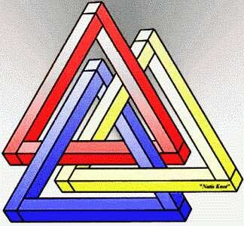
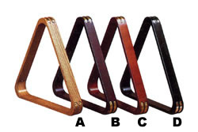
Printing Triangle
Live Demo

Slide 29
Optional Parameters
C# 4.0 supports optional parameters with default values assigned at their declaration:
The above method can be called in several ways:
static void PrintNumbers(int start = 0, int end = 100)
{
for (int i = start; i <= end; i++)
{
Console.Write("{0} ", i);
}
}
PrintNumbers(5, 10);
PrintNumbers(15);
PrintNumbers();
PrintNumbers(end: 40, start: 35);

Slide 30
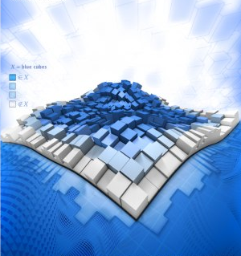
Optional Parameters
Live Demo

Slide 31

Returning Values From Methods

Slide 32
Returning Values From Methods
A method can return a value to its caller
Returned value:
Can be assigned to a variable:
Can be used in expressions:
Can be passed to another method:
string message = Console.ReadLine();
// Console.ReadLine() returns a string
float price = GetPrice() * quantity * 1.20;
int age = int.Parse(Console.ReadLine());

Slide 33
Defining Methods That Return a Value
Instead of void, specify the type of data to return
Methods can return any type of data (int, string, array, etc.)
void methods do not return anything
The combination of method's name and parameters is called method signature
Use return keyword to return a result
static int Multiply(int firstNum, int secondNum)
{
return firstNum * secondNum;
}

Slide 34
The return Statement
The return statement:
Immediately terminates method’s execution
Returns specified expression to the caller
Example:
To terminate void method, use just:
Return can be used several times in a method body
return -1;
return;

Slide 35

Returning Values From Methods
Examples

Slide 36
Returning Values From Methods
Examples

Slide 37
Temperature Conversion – Example
Convert temperature from Fahrenheit to Celsius:
static double FahrenheitToCelsius(double degrees)
{
double celsius = (degrees - 32) * 5 / 9;
return celsius;
}
static void Main()
{
Console.Write("Temperature in Fahrenheit: ");
double t = Double.Parse(Console.ReadLine());
t = FahrenheitToCelsius(t);
Console.Write("Temperature in Celsius: {0}", t);
}

Slide 38
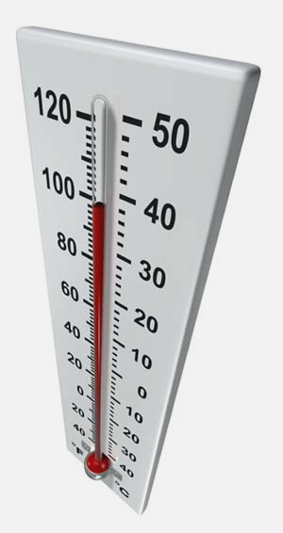
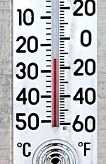
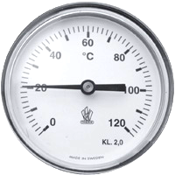
Temperature Conversion
Live Demo

Slide 39

Positive Numbers – Example
Check if all numbers in a sequence are positive:
static bool ArePositive(int[] sequence)
{
foreach (int number in sequence)
{
if (number <= 0)
{
return false;
}
}
return true;
}

Slide 40

Positive Numbers
Live Demo

Slide 41

Data Validation – Example
Validating input data:
using System;
class ValidatingDemo
{
static void Main()
{
Console.WriteLine("What time is it?");
Console.Write("Hours: ");
int hours = int.Parse(Console.ReadLine());
Console.Write("Minutes: ");
int minutes = int.Parse(Console.ReadLine());
// (The example continues on the next slide)

Slide 42
Data Validation – Example
bool isValidTime =
ValidateHours(hours) &&
ValidateMinutes(minutes);
if (isValidTime)
Console.WriteLine("It is {0}:{1}",
hours, minutes);
else
Console.WriteLine("Incorrect time!");
}
static bool ValidateMinutes(int minutes)
{
bool result = (minutes>=0) && (minutes<=59);
return result;
}
static bool ValidateHours(int hours) { ... }
}

Slide 43

Data Validation
Live Demo

Slide 44

Overloading Methods
Multiple Methods with the Same Name

Slide 45
Overloading Methods
What means "to overload a method name"?
Use the same method name for multiple methods with different signature (parameters)
static void Print(string text)
{
Console.WriteLine(text);
}
static void Print(int number)
{
Console.WriteLine(number);
}
static void Print(string text, int number)
{
Console.WriteLine(text + ' ' + number);
}

Slide 46

Variable Number of Parameters

Slide 47
Variable Number of Parameters
A method in C# can take variable number of parameters by specifying the params keyword
static long CalcSum(params int[] elements)
{
long sum = 0;
foreach (int element in elements)
sum += element;
return sum;
}
static void Main()
{
Console.WriteLine(CalcSum(2, 5));
Console.WriteLine(CalcSum(4, 0, -2, 12));
Console.WriteLine(CalcSum());
}

Slide 48
Methods – Best Practices
Each method should perform a single, well-defined task
Method’s name should describe that task in a clear and non-ambiguous way
Good examples: CalculatePrice, ReadName
Bad examples: f, g1, Process
In C# methods should start with capital letter
Avoid methods longer than one screen
Split them to several shorter methods

Slide 49
Summary
Break large programs into simple methods that solve small sub-problems
Methods consist of declaration and body
Methods are invoked by their name
Methods can accept parameters
Parameters take actual values when calling a method
Methods can return a value or nothing

Slide 50
Methods
http://csharpfundamentals.telerik.com

Slide 51
Exercises
Write a method that asks the user for his name and prints “Hello, <name>” (for example, “Hello, Peter!”). Write a program to test this method.
Write a method GetMax() with two parameters that returns the bigger of two integers. Write a program that reads 3 integers from the console and prints the biggest of them using the method GetMax().
Write a method that returns the last digit of given integer as an English word. Examples: 512 🡪 "two", 1024 🡪 "four", 12309 🡪 "nine".

Slide 52
Exercises (2)
Write a method that counts how many times given number appears in given array. Write a test program to check if the method is working correctly.
Write a method that checks if the element at given position in given array of integers is bigger than its two neighbors (when such exist).
Write a method that returns the index of the first element in array that is bigger than its neighbors, or -1, if there’s no such element.
Use the method from the previous exercise.

Slide 53
Exercises (3)
Write a method that reverses the digits of given decimal number. Example: 256 🡪 652
Write a method that adds two positive integer numbers represented as arrays of digits (each array element arr[i] contains a digit; the last digit is kept in arr[0]). Each of the numbers that will be added could have up to 10 000 digits.
Write a method that return the maximal element in a portion of array of integers starting at given index. Using it write another method that sorts an array in ascending / descending order.

Slide 54
Exercises (4)
Write a program to calculate n! for each n in the range [1..100]. Hint: Implement first a method that multiplies a number represented as array of digits by given integer number.
Write a method that adds two polynomials. Represent them as arrays of their coefficients as in the example below:
x² + 5 = 1x² + 0x + 5 🡪
Extend the program to support also subtraction and multiplication of polynomials.
5 | 0 | 1

Slide 55
Exercises (5)
Write a program that can solve these tasks:
Reverses the digits of a number
Calculates the average of a sequence of integers
Solves a linear equation a * x + b = 0
Create appropriate methods.
Provide a simple text-based menu for the user to choose which task to solve.
Validate the input data:
The decimal number should be non-negative
The sequence should not be empty
a should not be equal to 0

Slide 56
Exercises (6)
Write methods to calculate minimum, maximum, average, sum and product of given set of integer numbers. Use variable number of arguments.
* Modify your last program and try to make it work for any number type, not just integer (e.g. decimal, float, byte, etc.). Use generic method (read in Internet about generic methods in C#).

Slide 57
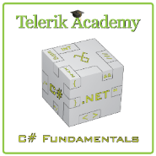



Free Trainings @ Telerik Academy
“C# Programming @ Telerik Academy
csharpfundamentals.telerik.com
Telerik Software Academy
academy.telerik.com
Telerik Academy @ Facebook
facebook.com/TelerikAcademy
Telerik Software Academy Forums
forums.academy.telerik.com

